Slide 1
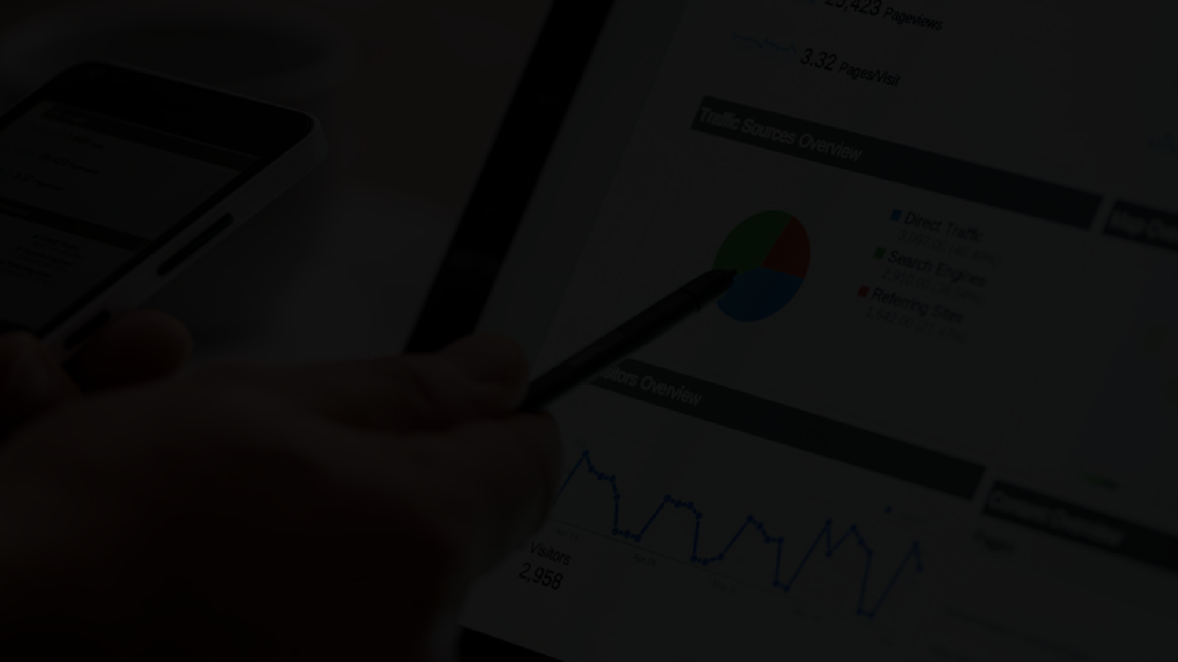
Customer Segmentation

Slide 2

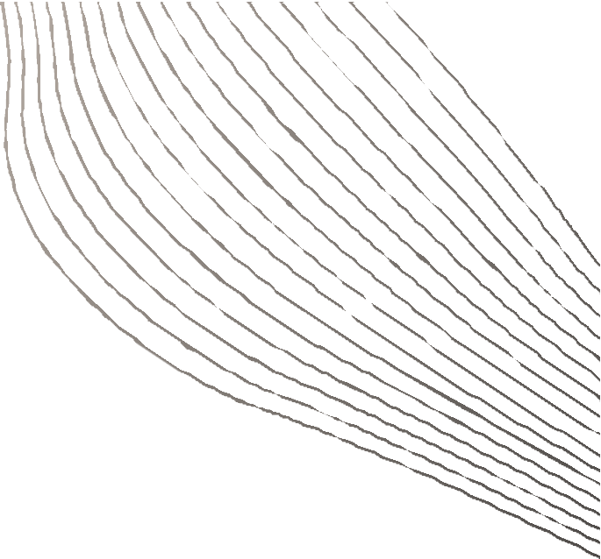
Content
01
02
03
04
05
06
07
08
09
10
11
12
13
14
15
16
ABSTRACT
PROPOSED SYSTEM
INTRODUCTION
METHODOLOGY
WHAT IS CUSTOMER SEGMENTATION?
ALGORITHMS
BENEFITS OF CUSTOMER SEGMENTATION
ADVANTAGES OF THE PROJECT
LITERATURE SURVEY
SCOPE
EXISTING SYSTEM
CONCLUSION
PROBLEM STATEMENT
REFERENCES
OBJECTIVES
BIBLIOGRAPHY

Slide 3
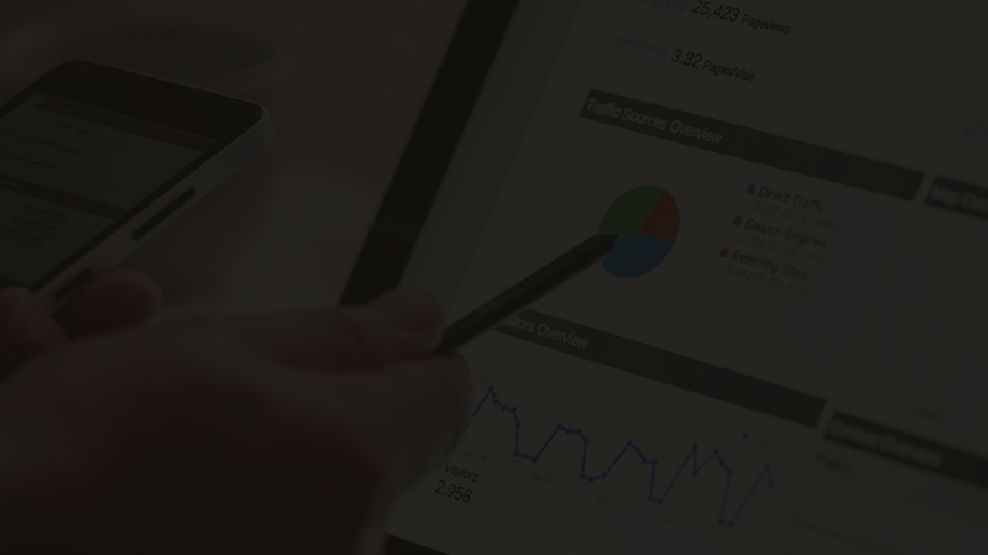
Abstract
Customer segmentation
is important in both customer
relationship literature and software. This project focuses on the significance of customer segmentation in businesses, highlighting its use in k- means algorithm. It emphasizes the role of customer segmentation in marketing strategy, helping businesses understand their customers better and tailor products or services to meet their needs. The segmented data is analyzed to differentiate between premium and standard customers.

Slide 4
Introduction
In today' s business world, understanding your customers is more important than ever. That' s where customer segmentation comes in. By dividing your customers into distinct groups based on their characteristics and behavior, you can tailor your marketing efforts . But how do you go about doing this? That' s where k- means comes in picture K- means is a powerful algorithm that helps businesses cluster customer data into meaningful groups, providing valuable insights into their needs and preferences. However, identifying the right criteria for segmentation can be challenging, and businesses must balance meaningful, actionable, and easy- to- understand segments with accurate and up- to- date data to accurately reflect the customer base.

Slide 5
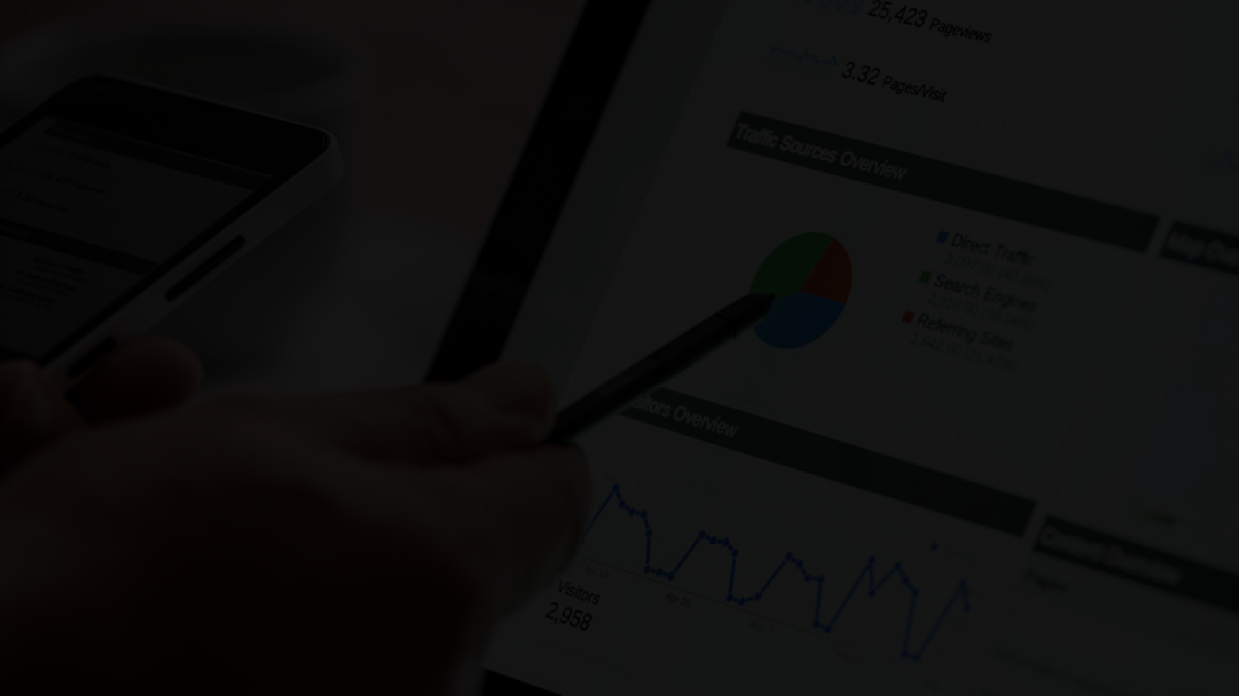

What is Customer Segmentation?
Customer segmentation is the process of dividing a customer base into groups of individuals that share similar characteristics or behaviors. It's a powerful tool that helps businesses better understand their customers and develop more effective marketing strategies.

Slide 6
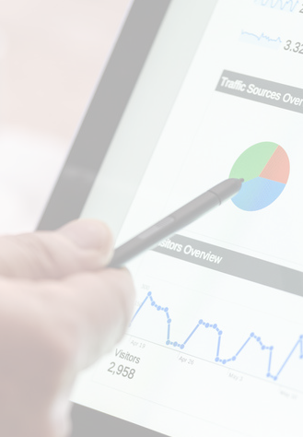



Optimize marketing
Market
Expansion:
resources by focusing on high-potential
customer segments.
Benefits of customer segmentation
Understand customer behavior patterns and preferences.
Behavior Insights:
Identify and
categorize customers based on shared
characteristics.
Enhanced Targeting:

Slide 7

Literature survey
SR NO. | Year | Author | Journal | Title of the paper | Result reported
1 | 2018 | Tushar Kansal, Suraj Bahuguna, Vishal Singh, Tanupriya Choudhury | IEEE Explore | Customer Segmentation using K-means Clustering | In that paper different clustering algorithms (k-Means, Agglomerative, and Meanshift) are been implemented to segment the customers and finally compare the results of clusters obtained from the algorithms.
2 | 2020 | EYL Nandapala, K.PN Jayasena | IEEE Explore | The practical approach in Customers segmentation by using the K-Means Algorithm | In this study they have mentioned about customer relationship management (CRM). With the help of K-means clustering they have identified the customer clearly so that, the organisation can make accurate decisions and do the changes in service
3 | 2018 | Şükrü Ozan | IEEE Explore | A Case Study on Customer Segmentation by using Machine Learning Methods | This study proposes to solve a customer segmentation problem of a company by using customers' information. The methods are inherited from machine learning algorithm .

Slide 8
Existing System
The current customer segmentation system is manual, time- consuming, and error-prone. Businesses use demographic data like age, gender, and spending habits, but this approach lacks insights into customer behavior. Traditional methods don't consider the dynamic nature of customer behavior, making it difficult for businesses to keep up. K- means clustering offers a powerful solution for customer segmentation.

Slide 9
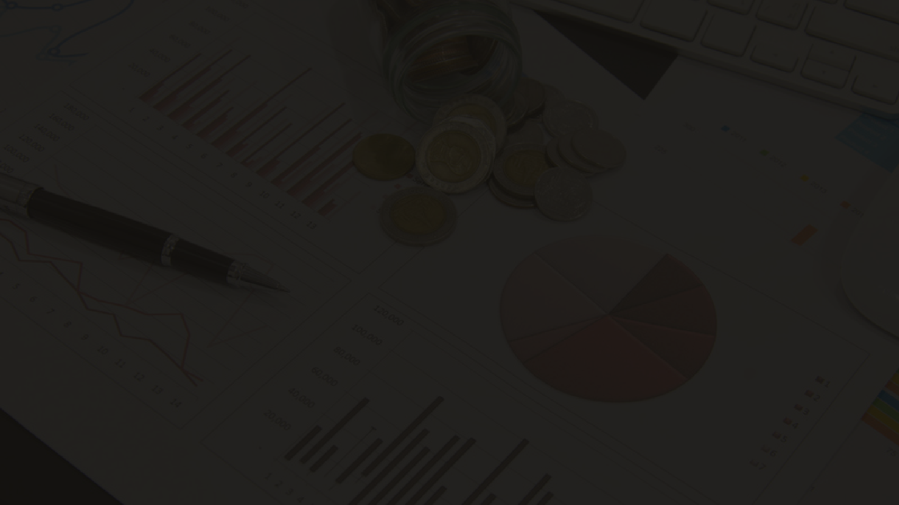

Problem Statement
The issue lies in conducting a customer analysis for grocery stores, which can be time-consuming and challenging due to manual processes. So the goal is to conduct a detailed customer analysis for grocery stores, focusing on understanding and categorizing customer preferences and behaviors. The aim is to identify trends, patterns, and insights that can guide business strategies for improving the shopping experience and customer satisfaction.

Slide 10
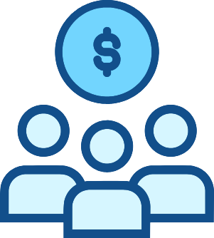

Objectives
01
02
03
04
To tailor their marketing
efforts and product
offerings.
To locate or identify the
tastes, buying motives, needs, priorities and
preferences of the customers.
To f ind the most attractive
segment for a particular
product or service.
To determine marketing
strategies, targets, and
goals.

Slide 11
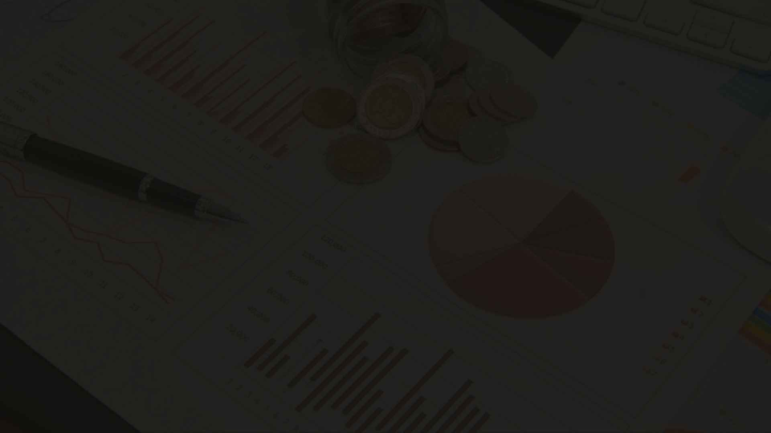
Proposed system
The system will be
able to identify new
customer segments and
track changes in
customer behavior over time using k- means
clustering to segment customers based on
and
their purchasing habits, demographics,
other relevant factors.
This will allow businesses to identify patterns and trends among their customers that may not be immediately apparent. By doing so, they can develop targeted marketing campaigns, improve customer retention, and ultimately increase profitability

Slide 12


Methodology
2
Data cleaning & transfromation
4
RFM Analysis & apply k -means
1
Data Selection
3
Data Visualization
5
Classifying Customers and Analyzing Patterns Using Apriori
6
Add model to website using Streamlit
7
Launch the website & display the dashboard

Slide 13
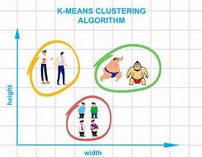
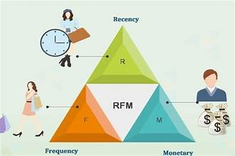
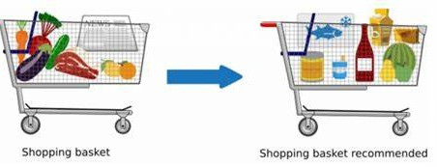
Algorithms
RFM (Recency Frequency Monetary)
The freshness of the customer activity, be it purchases or visits
The frequency of the customer transactions or visits
The intention of customer to spend or purchasing power of customer
Apriori Algorithm
Apriori Algorithm is a widely-used and well-known Association Rule algorithm and is a popular algorithm used in market basket analysis.. It helps to f ind frequent itemsets in transactions and identif ies association rules between these items.
K-means
K-means is a powerful tool for businesses looking to segment their customer. This allows businesses to tailor their marketing strategies to specific customer segments and improve customer satisfaction and loyalty.

Slide 14
Advantages of Projects
DASHBOARD AND VISULZATIONS
Use intercative charts to communicate info more effectively.
CUSTOMER LOYALTY PROGRAMS
based on data insights, encouraging repeat business and fostering long-term relationships with your customers.
PROFITABILITY ANALYSIS
Use for make informed decisions about pricing, promotions, and product selection
LOCALIZED MARKETING STRATEGIES
The grocery store should cater to the unique needs of its community by focusing on its customer base.

Slide 15
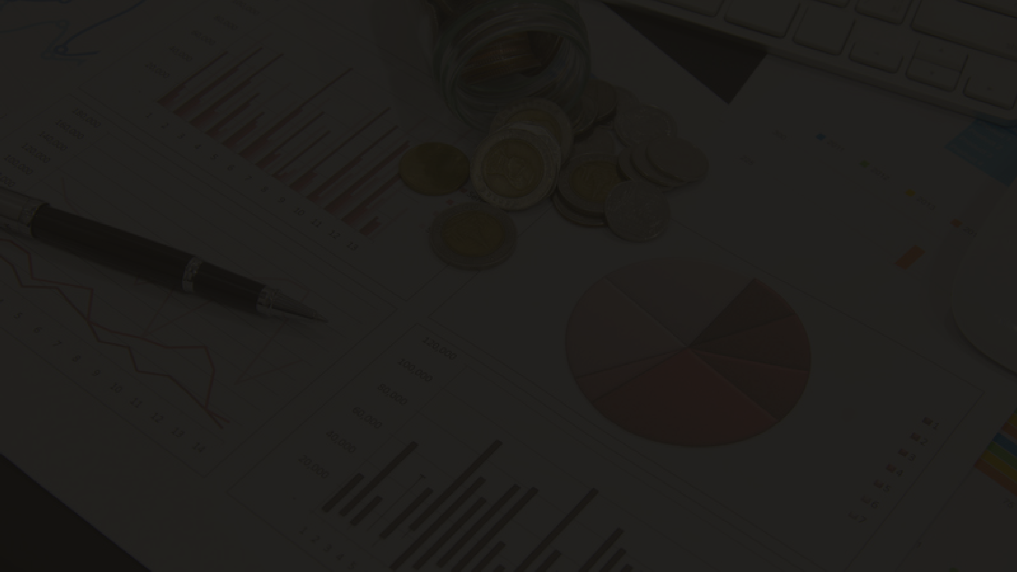
Scope
Targeted Marketing
Pricing Strategies
Customer Retention
Customer Experience
Product Development
Risk Management
Inventory Management
Geographic Expansion

Slide 16
Conclusion
This project demonstrates the power of customer segmentation in businesses. Through data analysis and techniques, it categorized customers into distinct groups with unique characteristics. This enables tailoring marketing strategies and product recommendations, enhancing customer engagement, satisfaction, and business success. It also optimizes resource allocation, inventory management, and operations, fostering efficiency and customer-centricity. Future research and enhancements will improve the model.

Slide 17
References
[1]Kansal, Tushar, Suraj Bahuguna, Vishal Singh, and Tanupriya Choudhury . "Customer segmentation using K-means clustering." In 2018 international
conference on computational techniques, electronics
and IEEE,
mechanical
2018.
systems (CTEMS), pp. 135-139.
doi:10.1109/CTEMS.2018.8769171
Nandapala, E. Y. L., and K. P. N. Jayasena. "The practical approach in Customers segmentation by using the K-Means Algorithm." 2020 IEEE 15th International Conference on Industrial and Information Systems (ICIIS).
IEEE, 2020. doi: 10.1109/ICIIS51140.2020.9342639
Ozan, Şükrü. "A case study on customer segmentation by using machine learning methods." 2018 International Conference on Artificial Intelligence and Data Processing (IDAP). IEEE, 2018. doi: 10.1109/IDAP.2018.8620892

Slide 18


Bibliography
https://ieeexplore.ieee.org/document/8769171
https://ieeexplore.ieee.org/document/9342639 https://ieeexplore.ieee.org/document/8620892

Slide 19

Thank You

